Slide 1
An introduction to orthodontics
Proffit ch.1

Slide 2
Changing goals
1000 BC
1850 first text by Kingsley
1890 EH Angle
Occlusion :Normal ,CLI,CLII,CLIII
1940-50 Tweed ,Begg
Cephalometry
orthopedics

Slide 7
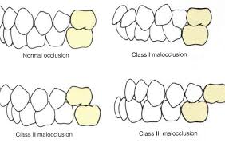

Slide 8
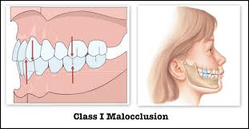

Slide 9
Modern goals
Soft tissue paradigm
Primary goal facial proportion
Secondary goal functional occlusion

Slide 11
Epidemiology
USPHS 1963-5 (6-11)
NHANESIII 1969-70 (12-17)
Why is malocclusion so prevalent?
Evolutionary trend
Jaw function

Slide 12
Treatment need
Psychosocial
Oral function
Injury or dental disease

Slide 13
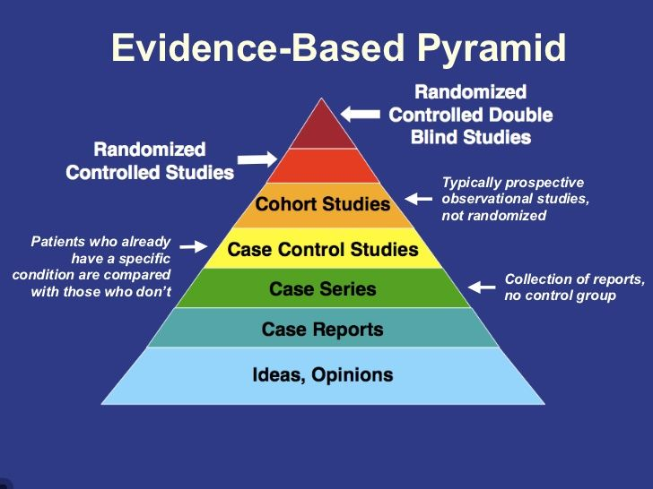
Types of treatment
Evidence based

Slide 14
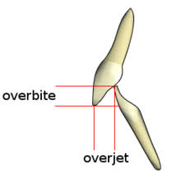
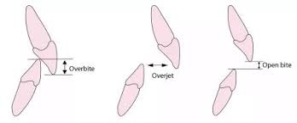
Over jet & Over bite

Slide 15
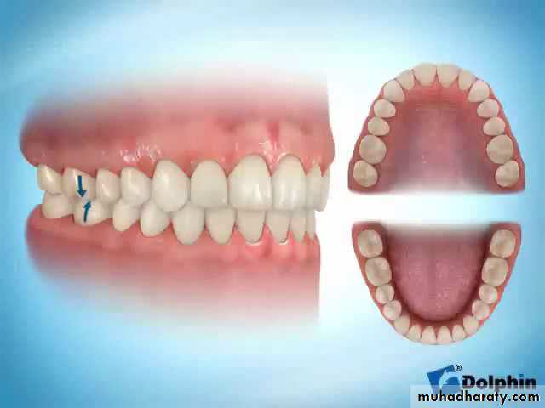

Slide 16
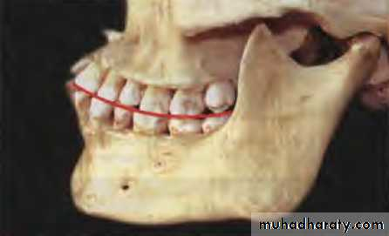

Slide 17
Line of occlusion

Slide 18
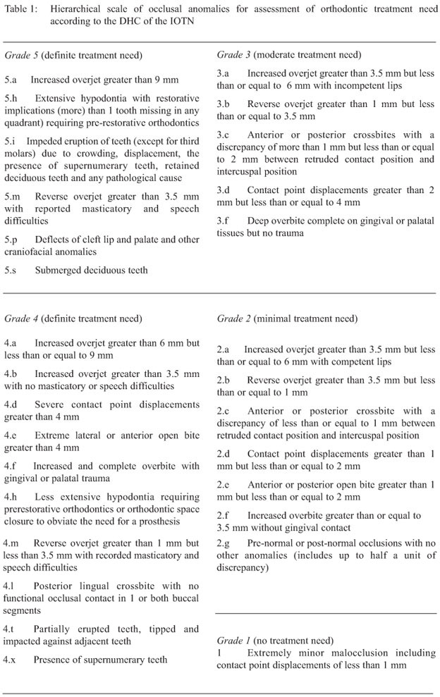
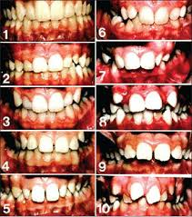
Demand for treatment
IOTN

Slide 19
Thank you

